Slide 1
Advanced Databases Lecture 7: Dimensional Model and ETL
Dr. Pierpaolo Dondio,

Slide 2
Extraction, Transformation, and Loading (ETL)
The “plumbing” work of data warehousing
Data are moved from source to target data bases
A very costly, time consuming part of data warehousing
Notes:
ETL tends to be “pick and shovel” work. Most organization’s data is even worse than imagined.

Slide 3
ETL Overview
Extraction Transformation Loading – ETL
To get data out of the source and load it into the data warehouse – simply a process of copying data from one database to other
Data is extracted from an OLTP database, transformed to match the data warehouse schema and loaded into the data warehouse database
Many data warehouses also incorporate data from non-OLTP systems such as text files, legacy systems, and spreadsheets; such data also requires extraction, transformation, and loading
When defining ETL for a data warehouse, it is important to think of ETL as a process, not a physical implementation

Slide 4
ETL Overview
ETL is often a complex combination of process and technology that consumes a significant portion of the data warehouse development efforts and requires the skills of business analysts, database designers, and application developers
It is not a one time event as new data is added to the Data Warehouse periodically – monthly, daily, hourly
Because ETL is an integral, ongoing, and recurring part of a data warehouse
Automated
Well documented
Easily changeable

Slide 5
Extraction

Slide 6
Data Extraction
Often performed by routines (not recommended because of high program maintenance and no automatically generated meta data)
Sometimes source data is copied to the target database using the replication capabilities of standard RDMS (not recommended because of “dirty data” in the source systems)
Increasing performed by specialized ETL software
Notes:
It’s changing, but COBOL extracts are still the most common ETL process. There are multiple reasons for this -- the cost of specialized ETL software, in-house programmers who have a good knowledge of the COBOL based source systems that will be used, and the peculiarities of the source systems that make the use of ETL software difficult.

Slide 7
Extraction
The integration of all of the disparate systems across the enterprise is the real challenge to getting the data warehouse to a state where it is usable
Data is extracted from heterogeneous data sources
Each data source has its distinct set of characteristics that need to be managed and integrated into the ETL system in order to effectively extract data.

Slide 8
Extraction
ETL process needs to effectively integrate systems that have different:
DBMS
Operating Systems
Hardware
Communication protocols
Need to have a logical data map before the physical data can be transformed
The logical data map describes the relationship between the extreme starting points and the extreme ending points of your ETL system usually presented in a table or spreadsheet

Slide 9
Target |  |  | Source |  |  | Transformation
Table Name | Column Name | Data Type | Table Name | Column Name | Data Type
Logical Mapping
The content of the logical data mapping document has been proven to be the critical element required to efficiently plan ETL processes
The table type gives us our queue for the ordinal position of our data load processes—first dimensions, then facts.
The primary purpose of this document is to provide the ETL developer with a clear-cut blueprint of exactly what is expected from the ETL process. This table must depict, without question, the course of action involved in the transformation process
The transformation can contain anything from the absolute solution to nothing at all. Most often, the transformation can be expressed in SQL. The SQL may or may not be the complete statement

Slide 10
Transformation

Slide 11
Data Staging
Often used as an interim step between data extraction and later steps
Accumulates data from asynchronous sources using native interfaces, flat files, FTP sessions, or other processes
At a predefined cutoff time, data in the staging file is transformed and loaded to the warehouse
There is usually no end user access to the staging file
An operational data store may be used for data staging
Notes:
Data staging is used in cleansing, transforming, and integrating the data.

Slide 12
Data Transformation
Transforms the data in accordance with the business rules and standards that have been established
Example include: format changes, deduplication, splitting up fields, replacement of codes, derived values, and aggregates
Notes:
Aggregates, such as sales totals, are often precalculated and stored in the warehouse to speed queries that require summary totals.

Slide 13
Transformation
Main step where the ETL adds value
Actually changes data and provides guidance whether data can be used for its intended purposes
Performed in staging area

Slide 14
Transformation
Data Quality paradigm
Correct
Unambiguous
Consistent
Complete
Data quality checks are run at 2 places - after extraction and after cleaning and confirming additional check are run at this point

Slide 15
Data Cleansing
Source systems contain “dirty data” that must be cleansed
ETL software contains rudimentary data cleansing capabilities
Specialized data cleansing software is often used. Important for performing name and address correction and householding functions
Leading data cleansing vendors include Vality (Integrity), Harte-Hanks (Trillium), and Firstlogic (i.d.Centric)
Notes:
Data cleansing is critical to customer relationship management initiatives.

Slide 16
Reasons for “Dirty” Data
Dummy Values
Absence of Data
Multipurpose Fields
Cryptic Data
Contradicting Data
Inappropriate Use of Address Lines
Violation of Business Rules
Reused Primary Keys,
Non-Unique Identifiers
Data Integration Problems
Notes:
Here’s a couple of examples:
Dummy data -- a clerk enters 999-99-9999 as a SSN rather than asking the customer for theirs.
Reused primary keys -- a branch bank is closed. Several years later, a new branch is opened, and the old identifier is used again.

Slide 17
Steps in Data Cleansing
Parsing
Correcting
Standardizing
Matching
Consolidating
Notes:
A good example to use is cleansing customer data. Most students can identify with receiving multiple copies of the same catalog because the company is not doing a good data cleansing job.

Slide 18
Parsing
Parsing locates and identifies individual data elements in the source files and then isolates these data elements in the target files.
Examples include parsing the first, middle, and last name; street number and street name; and city and state.
Notes:
The record is broken down into atomic data elements.

Slide 19
Correcting
Corrects parsed individual data components using sophisticated data algorithms and secondary data sources.
Example include replacing a vanity address and adding a zip code.
Notes:
External data, such as census data, is often used in this process.

Slide 20
Standardizing
Standardizing applies conversion routines to transform data into its preferred (and consistent) format using both standard and custom business rules.
Examples include adding a pre name, replacing a nickname, and using a preferred street name.
Notes:
Companies decide on the standards that they want to use.

Slide 21
Matching
Searching and matching records within and across the parsed, corrected and standardized data based on predefined business rules to eliminate duplications.
Examples include identifying similar names and addresses.
Notes:
Commercial data cleansing software often uses AI techniques to match records.

Slide 22
Consolidating
Analyzing and identifying relationships between matched records and consolidating/merging them into ONE representation.
Notes:
All of the data are now combined in a standard format.

Slide 23
Data Transformation Examples
Selecting only certain columns to load (or selecting null columns not to load
Translating coded values (e.g., if the source system stores 1 for male and 2 for female, but the warehouse stores M for male and F for female), this calls for automated data cleansing; no manual cleansing occurs during ETL
Encoding free-form values (e.g., mapping "Male" to "1" and "Mr" to M)
Deriving a new calculated value (e.g., sale_amount = qty * unit_price)
Sorting
Joining data from multiple sources (e.g., lookup, merge)
Aggregation (for example, rollup — summarizing multiple rows of data — total sales for each store, and for each region, etc.)
Transposing or pivoting (turning multiple columns into multiple rows or vice versa)
Splitting a column into multiple columns (e.g., putting a comma-separated list specified as a string in one column as individual values in different columns)
Disaggregation of repeating columns into a separate detail table (e.g., moving a series of addresses in one record into single addresses in a set of records in a linked address table)
Applying any form of simple or complex data validation. If validation fails, it may result in a full, partial or no rejection of the data, and thus none, some or all the data is handed over to the next step, depending on the rule design and exception handling.

Slide 24
Loading
Loading Dimensions
Loading Facts

Slide 25
Data Loading
Data are physically moved to the data warehouse
The loading takes place within a “load window”
The trend is to near real time updates of the data warehouse as the warehouse is increasingly used for operational applications
Notes:
Most loads involve only change data rather than a bulk reloading of all of the data in the warehouse.

Slide 26
Loading Dimensions
The primary key is a single field containing meaningless unique integer – Surrogate Keys
The DW owns these keys and never allows any other entity to assign them
De-normalized flat tables – all attributes in a dimension must take on a single value in the presence of a dimension primary key.
Should possess one or more other fields (attributes)

Slide 27
Loading Dimension
The data loading module consists of all the steps required to administer slowly changing dimensions (SCD) and write the dimension to disk as a physical table in the proper dimensional format with correct primary keys, and final descriptive attributes.
Creating and assigning the surrogate keys occur in this module.

Slide 28
Loading
Slow Changing Dimensions

Slide 29
Loading dimensions that change
When DW receives notification that an existing row in dimension has changed it gives out 3 types of responses
Type 1
Type 2
Type 3

Slide 30
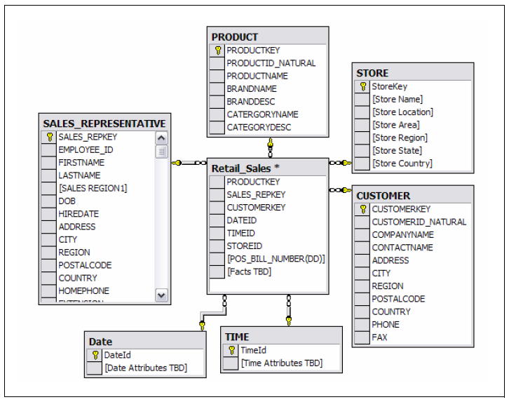
Example for Discussion

Slide 31
Type 1 –Overwriting the History
A Type-1 approach overwrites the existing dimensional attribute with new data, and therefore no history is preserved.
Spelling error (it makes sense)
From California to New Jersey?
SKEY | EMPL_ID | LASTNAME | FIRSTNAME | REGION
976735 | DF134A | Seles | Monnica | California

Slide 32
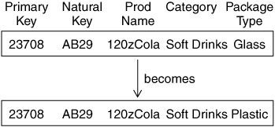
Type 1 Dimension

Slide 33
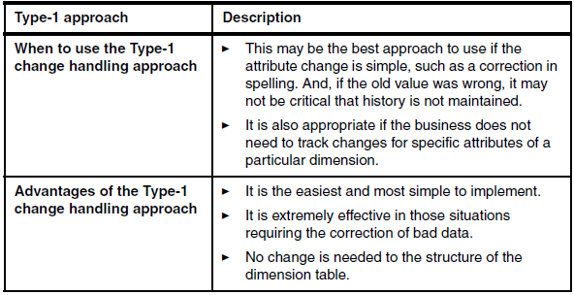
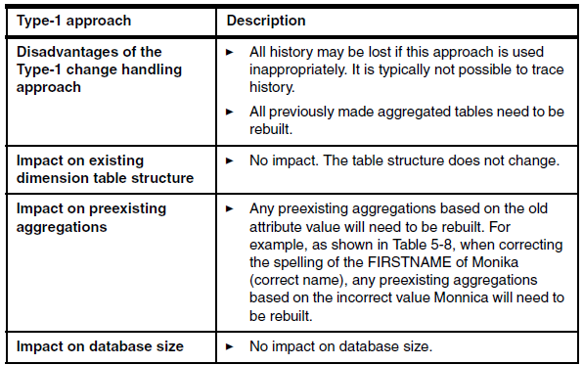
Type 1 - Summary

Slide 34
Type 2 – Preserving History
Type 2 adds a new dimension row
Facts related to Monica are now partitioned
Note the use of Surrogate Key
The problem of expiration date (when the change happened?)
SKEY | EMPL_ID | LASTNAME | FIRSTNAME | REGION
976735 | DF134A | Seles | Monica | California
976736 | DF134A | Seles | Monica | New Jersey

Slide 35
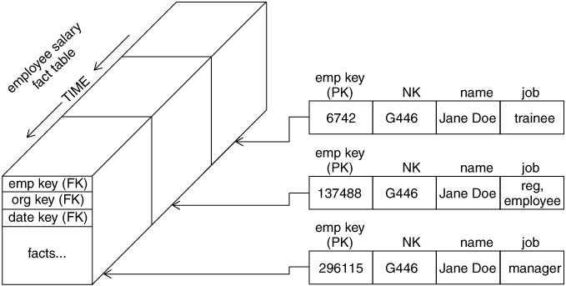
Type 2 Dimension

Slide 36
Expiration Date
There is no need to include effective date attributes inside the dimension
The Date/Time dimension will find the right data
Granularity is important
Effective and expiration date attributes are necessary in the staging area because we need to know which surrogate key is valid when loading historical fact records.
you may still use them as helpful extras that are not required for the basic partitioning of history.
You can get the same answer by partitioning history using the date or time dimension of your dimensional designs.

Slide 37
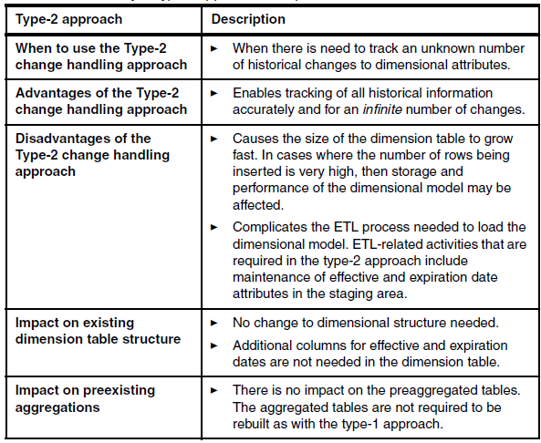
Type 2 - Summary

Slide 38
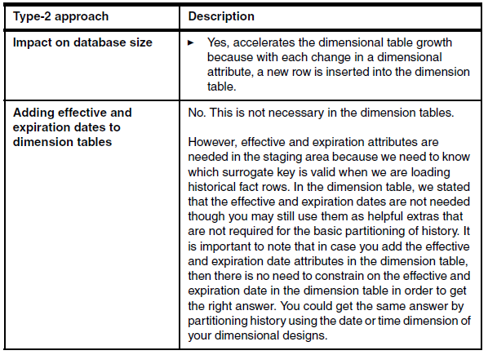
Type 2 - Summary

Slide 39
Type 3 – Preserving Limited History
The type-3 approach is typically used only if there is a limited need to preserve and accurately describe history. An example is when someone gets married and there is a need to retain the original surname of the person
With this design I only keep one change, I need to add more fields to track more changes
The type-3 approach enables us to see new and historical fact
table rows by either the new or prior attribute values.
SKEY | EMPL_ID | OLDLNAME | NEWLNAME | FIRSTNAME | REGION
976735 | DF134A | Seles | Sampras | Monica | California

Slide 40
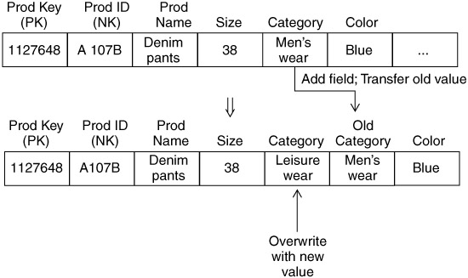
Type 3 Dimensions

Slide 41
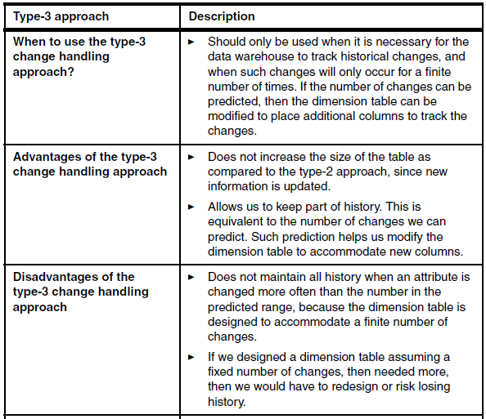
Type 3 - Summary

Slide 42
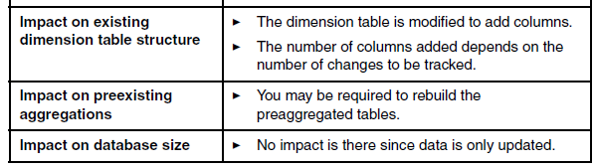
Type 3 - Summary

Slide 43
Type of Facts

Slide 44
Non-Additive
They cannot be added meaningfully
Textual facts: cannot add, but count
Per-Unit Prices: can add only if you know number of units sold
Percentage and Ratios: non additive, keep denominator and numerator when possible
Measure of Intensity: room temperature
Averages
Degenerate Numbers: order numbers…

Slide 45
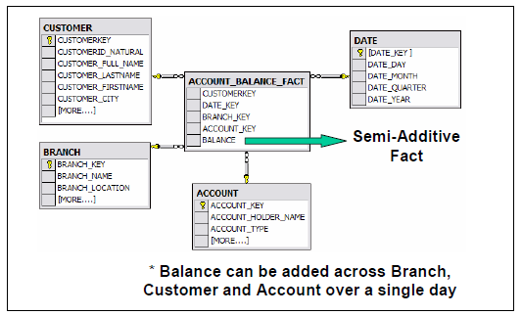
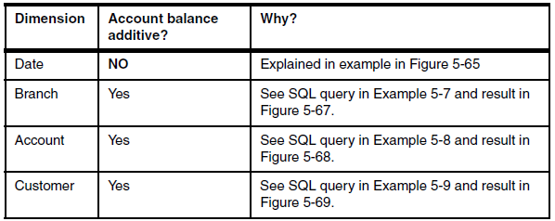
Semi-Additive
Additive across some dimensions but not on all of them
Account Balances
The balance is not additive across time
It is obviously possible across customers
Quantity on hand!
Date no, Product Store yes

Slide 46
Loading facts
Facts
Fact tables hold the measurements of an enterprise. The relationship between fact tables and measurements is extremely simple. If a measurement exists, it can be modeled as a fact table row. If a fact table row exists, it is a measurement

Slide 47
Key Building Process - Facts
When building a fact table, the final ETL step is converting the natural keys in the new input records into the correct, contemporary surrogate keys
ETL maintains a special surrogate key lookup table for each dimension. This table is updated whenever a new dimension entity is created and whenever a Type 2 change occurs on an existing dimension entity
All of the required lookup tables should be pinned in memory so that they can be randomly accessed as each incoming fact record presents its natural keys. This is one of the reasons for making the lookup tables separate from the original data warehouse dimension tables.

Slide 48
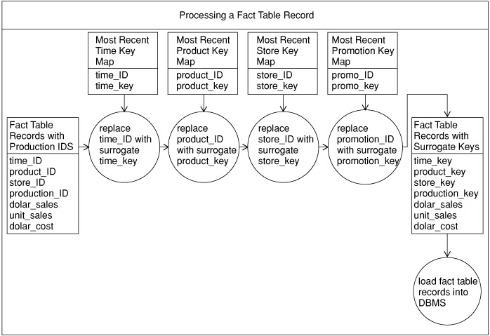
Key Building Process

Slide 49
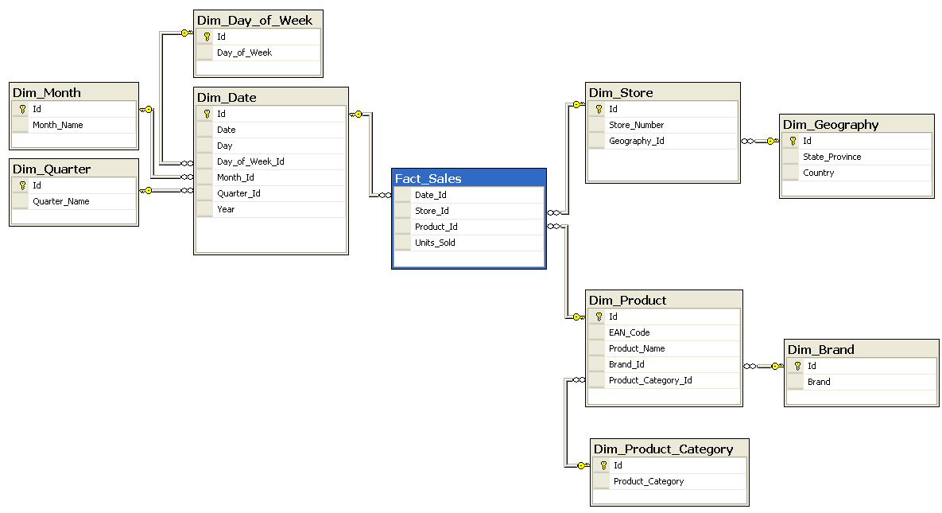
Facts and Dimensions

Slide 50
Query Example
SELECT B.Brand, G.Country, SUM (F.Units_Sold) FROM Fact_Sales F INNER JOIN Dim_Date D ON F.Date_Id = D.Id INNER JOIN Dim_Store S ON F.Store_Id = S.Id INNER JOIN Dim_Geography G ON S.Geography_Id = G.Id INNER JOIN Dim_Product P ON F.Product_Id = P.Id INNER JOIN Dim_Brand B ON P.Brand_Id = B.Id WHERE D.Year = 1997 AND C.Product_Category = 'tv' GROUP BY B.Brand, G.Country

